Slide 1




AIR CANVAS: REAL-TIME VIRTUAL DRAWING USING HAND MOTION
PRESENTED BY:
ANUSHKA GUPTA
102303358

Slide 2

PROBLEM STATEMENT
With the rise of contactless interaction, there is a need for intuitive drawing methods that don't rely on physical tools.
This project solves that problem by allowing users to draw in real-time using only a webcam and a colored object.
It demonstrates the power of computer vision in creating interactive virtual tools.

Slide 3
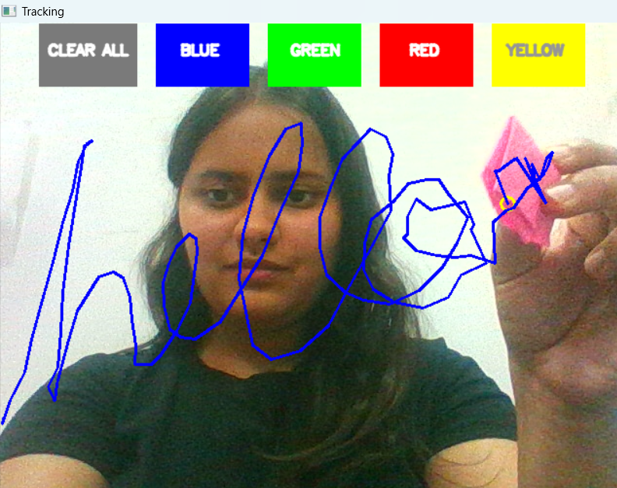
To design and implement a real-time virtual canvas using computer vision.
Use OpenCV and Python to detect a colored object (like a pen cap) in webcam feed.
OBJECTIVE
Provide interactive controls like color selection and canvas clearing.
Allow users to draw on screen by simply moving that object in the air.

Slide 4
TOOLS AND LIBRARIES UESD
PYTHON 3.X:
Programming language used to build the application.
OPENCV:
Open-source computer vision library for image processing and webcam access.
NUMPY:
Library for handling arrays and matrix operations.
WEBCAM:
Input device for capturing real-time video frames.

Slide 5
HOW IT WORKS (STEP-BY-STEP FLOW)
1. Video Capture:
Webcam captures real-time video frames.
2. Colour Conversion:
Each frame is converted from BGR to HSV colour space.
3.SV Range Detection:
The user adjusts the trackbars to define the colour range of their marker (e.g., a pink pen cap).
4.Contour Detection:
The app detects the largest contour (marker) and identifies its centre.
5.Action Trigger:
If the marker is over the colour buttons (top bar), it switches colours or clears the canvas.
6.Drawing:
As the marker moves, the system draws lines connecting racked points.

Slide 6
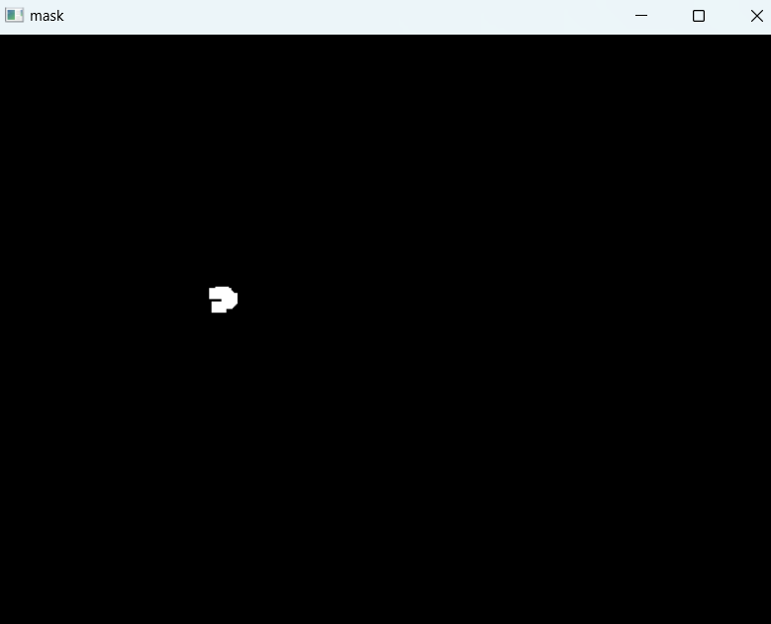
HSV DETECTION IN ACTION
1. HSV Trackbars allow live tuning of detection range:
Hue: colour type
Saturation: intensity
Value: brightness
2. Binary Mask Window:
Shows what is currently being detected (white = detected object)
“Proper HSV tuning is critical to ensure the system detects only the intended object and not the background or hair.”

Slide 7
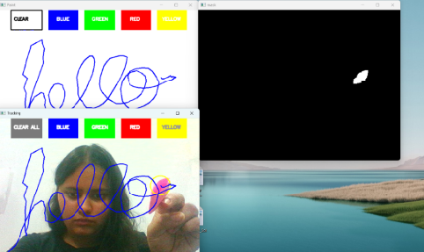
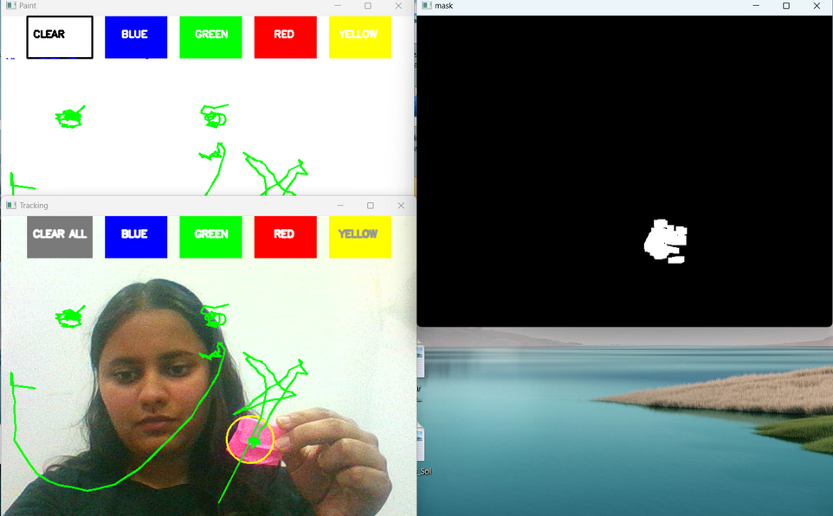
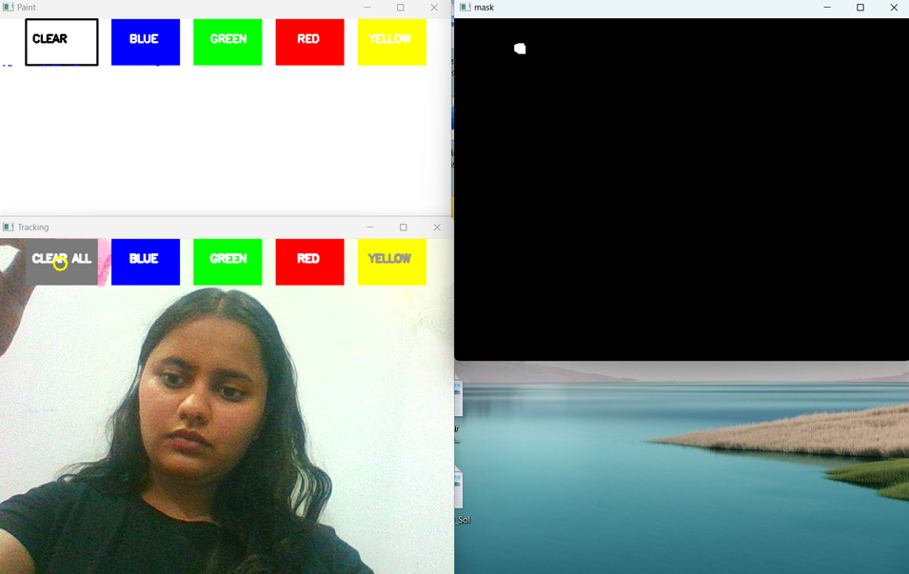
DRAWING OUTPUT

Slide 8
APPLICATIONS
Touchless Interaction Systems
Useful in hygiene-sensitive environments (e.g., hospitals)
Educational Tools
Fun and engaging tech for kids to draw and learn
Gesture-Controlled Interfaces
Prototype for future AR/VR and smart TV control
Rehabilitation & Therapy
Could be adapted for motor skill training

Slide 9
CHALLENGES & FUTURE SCOPE
Challenges Faced:
HSV tuning sensitivity to lighting
False detection of face/hair if background was similar in color
Webcam latency and flickering
Future Improvements:
Add fingertip detection using MediaPipe
Export drawings as images
Add gesture-based commands (e.g., wave = undo)
Integrate voice commands for interaction

Slide 10
THANK YOU
📩 Anushka Gupta
🧾 102303358
🎓 Thapar Institute of Engineering & Technology

